Slide 1
Data visualization & Analytics
Project -1 Startups

Slide 2
Safety Moment
In Case of a Fire – Who knows where the stairs are?
Answer: Go out the door , turn to the right and
stairs are immediately on your left.
Notes:
At my last company, safety moments were an important to share important and sometimes personal learnings about safety or unsafe situations.

Slide 3
Our Project –Startups
Startup behind ridiculed $400 juicer shuts down
It turns out that selling a $400 Internet-connected juicer isn't a recipe for success after all.
Juicero, a startup that was widely ridiculed for selling an absurdly overpriced juice machine, is shutting down. The news was announced on its website Friday.
The company had raised about $120 million in funding from multiple prominent investors, including Google Ventures and Kleiner Perkins. Juicero's stated goal was to change how we consume fresh, organic foods.
From www.CNN.com - Article by Seth Fiegerman @sfiegerman
Notes:
Our project had Startups as the focus and what we could tell about them and their success as they moved through the different funding phases.

Slide 4
Data Gathering – User interface ($)
One Team member purchased a license for one month
Graphical user interface to search and build queries
Downloaded batches of 1000 records as csv files
Companies.csv
Funding_rounds.csv
Organization.csv – pre-made 103mb file
API access was limited for unknown reasons
Crunchbase support was unresponsive to requests for help
Notes:
Having to purchase a license to get any meaningful data was an impediment to our data gathering, and due to a limited number of us having data access, there were fewer eyes and minds on the task and able to put effort into understanding the data. Understanding and knowing the data is key to the correct interpretation, visualization, and presentation of a story, questions and answers.

Slide 5
Data Gathering – API interface
Free api was limited but we learned how to extract api data
print("The Crunchbase API responded with: " + json.dumps(org_json, indent=2) + ".")
Created org_df = pd.DataFrame() with empty columns
oname = org_json["data"]["items"][i]["properties"]["name"]
org_df.set_value(index, "name", oname)
Even with paid license we couldn’t access all json structures
This issue was never resolved
Notes:
The API turned out the be a dead-end due to it being inaccessible even for a paid license. We did gain insight in how the API was used and structured, but that didn’t help this project.

Slide 6
Data Gathering – Screen Scraping
browser.visit(t_url)
time.sleep(45)
soup = BeautifulSoup(html, "html.parser")
Print(soup.prettify()) – to read json structure
for line in soup.findAll(‘Html tag’, class_=‘engagement value’)
org2_df.set_value(index, "Total Visits", line.get_Text())
This method required a lot of work
Notes:
Screen scraping was harder than anticipated because the original data had the wrong URL for screen scraping. In addition, not understanding the data led to a time consuming process to retrieve URLs. Now, that the data is cleansed and better understood, the URLs are available without having to jump through hoops to get them.

Slide 7
Data cleansing
Converting currency strings to floats highlighted currency issues which were the caused of conversion problems. we ended up restricting our data extracts to us investments.
While cleaning the data for company website urls, we learned that multiple urls were possible for one company. We had to cleanse the data multiple times to get down to one company and one or more valid entries for each funding type.
Some pre-packaged csv files were too large for use in Github with additional software installations.
Notes:
Not all team members had access to extracting data because we had to purchase licenses to get any meaningful data. Therefore, data cleansing became more important but also problematic because the people cleaning weren’t as close to the data since they didn’t retrieve the data.

Slide 8
Funding Type and Status
Funding Type | Count
Seed | 5174
Series A | 2461
Series B | 904
Series C | 218
Series D | 41
Status | Count
Operating | 7982
Closed | 232
Acquired | 548
IPO | 36
Notes:
Our focus – Funding Types and Status tables.
Minimum Founded Date ‘2012-01-01’.
Maximum Closed Date ‘2017-08-26’.
We could have broken down status within each funding type, but we are focusing on Startup moving through funding phases and those that closed versus still operating.

Slide 9
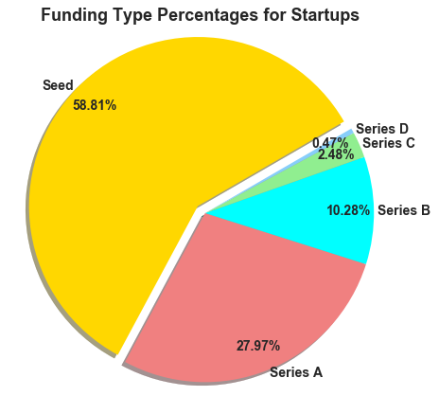
Funding Type by percentage
Notes:
This slide shows that the largest funding type is seed followed by Series A thru D. Seed funding is the starting funding while companies move thru Series A to Series D based on their success at fund raising but also hopefully on their actual and potential eventual success as a company. Coming slides will put this slide into better context.

Slide 10
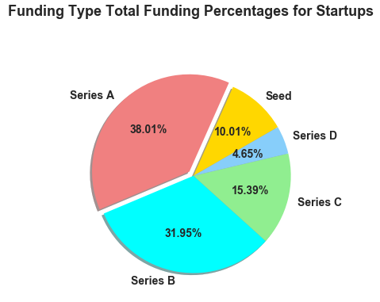
Funding type Total Funding Percentages
Notes:
This slide shows the total funding by funding type. As you can see, Seed funding total is only 10% while in the previous slide it was 58% of the funding types. Also, notice the percentages after Seed, starting with Series A to Series D get progressively smaller in terms of total funding. Some of the conclusions take a little time to absorb.

Slide 11
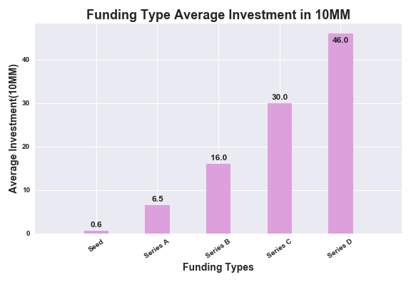
funding Type Average Investment
Notes:
This slide may be a little hard to read, even though we made all the text bold and increase the size. The numbers are in tens of millions, and go from Seed to Series D on the x-axis and from 0 to 50 million on the y-axis. Again look at the Seed average which $600,000 and around 46 million for Series D. So even though Series D had the smallest total funding, it has the largest average investment. Why is this? Are you able to draw conclusions yet?

Slide 12
Lessons Learned
Group Dynamics - Bruce Tuckman said that “teams go through 5 stages of development: forming, storming, norming, performing and adjourning”.
Our group:
Minimal Planning and no checkpoints
brainstorming session for story, questions, and data
No development of ideas or documentation beyond the initial session
No clear specifications or requirements for the charts and data
Communication
Slack was used (inconsistently)
Met in Class - no other working or planning meetings
using github became a hindrance
Used Google drive to share file
Notes:
This project was a lesson in group dynamics, a study of project management, and an experiment in letting human be human. What are the lessons learned?

Slide 13

Questions

Slide 14
Appendix
Rachel had the Startups idea (when we needed one)
www.Crunchbase.com – user interface and API
www.similarweb.com – Web scraping information
www.google.com – search engine and file storage/sharing
www.github.com - File storage/sharing
https://www.crummy.com/software/BeautifulSoup/bs4/doc

